Slide 1
Facial Emotion Recognition using CNN
NAME: V. VALLIAPPAN
REGISTER NO: 730321104059
NAAN MUDHALVAN ID: au730321104059
DEGREE: B.E – CSE
YEAR: III
COLLEGE NAME: BUILDERS ENGINEERING COLLEGE

Slide 2
Facial Emotion Recognition Using CNN – Convolutional Neural Networks

Slide 3

AGENDA
Introduction to Facial Emotion Recognition (FER)
Understanding Convolutional Neural Networks (CNNs)
Dataset Selection and Preprocessing
Building the CNN Model
Training the CNN Model
Fine-tuning and Optimization
Evaluation and Validation
Deployment and Real-world Applications
Future Directions and Challenges
Conclusion

Slide 4

PROBLEM STATEMENT
The objective of this project is to develop a robust and accurate Facial Emotion Recognition (FER) system using Convolutional Neural Networks (CNNs). The system will be capable of recognizing basic human emotions such as happiness, sadness, anger, surprise, fear, disgust, and neutrality from facial images.

Slide 5

PROJECT OVERVIEW
Facial Emotion Recognition (FER) is a crucial component in human-computer interaction systems, healthcare applications, and security systems. The ability to accurately detect and recognize human emotions from facial expressions has numerous practical implications. In this project, we aim to develop a Facial Emotion Recognition system using Convolutional Neural Networks (CNNs) to automatically detect and classify human emotions from facial images.

Slide 6

WHO ARE THE END USERS?
Human-Computer Interaction (HCI) Researchers and Developers
Healthcare Professionals
Educators and Trainers
Security and Surveillance Personnel
Market Researchers and Advertisers
Entertainment and Gaming Industry
General Public and End-Users

Slide 7
YOUR SOLUTION AND ITS VALUE PROPOSITION
Our solution utilizes state-of-the-art deep learning techniques, specifically Convolutional Neural Networks (CNNs), to accurately recognize and classify human emotions from facial expressions. By leveraging the power of CNNs, our system can learn complex patterns and features from facial images, enabling it to make nuanced and precise emotion predictions in real-time.
VALUE PROPOSITIONS :
Accuracy and Reliability
Real-time Inference
Adaptability and Robustness
Ethical Considerations
Versatility and Customizability

Slide 8
THE WOW IN YOUR SOLUTION
High Accuracy and Precision
Real-time Responsiveness
Adaptability to Diverse Conditions
Emotionally Intelligent Interactions
Ethical and Transparent Design
Seamless Integration and Customization
8

Slide 9
MODELLING
Data Preparation
Designing CNN Architecture
Adding Convolutional Layers
Adding Pooling Layers
Flattening and Adding Fully Connected Layers
Output Layer and Activation
Model Compilation
Training the Model
Hyperparameter Tuning
Model Evaluation
9

Slide 10
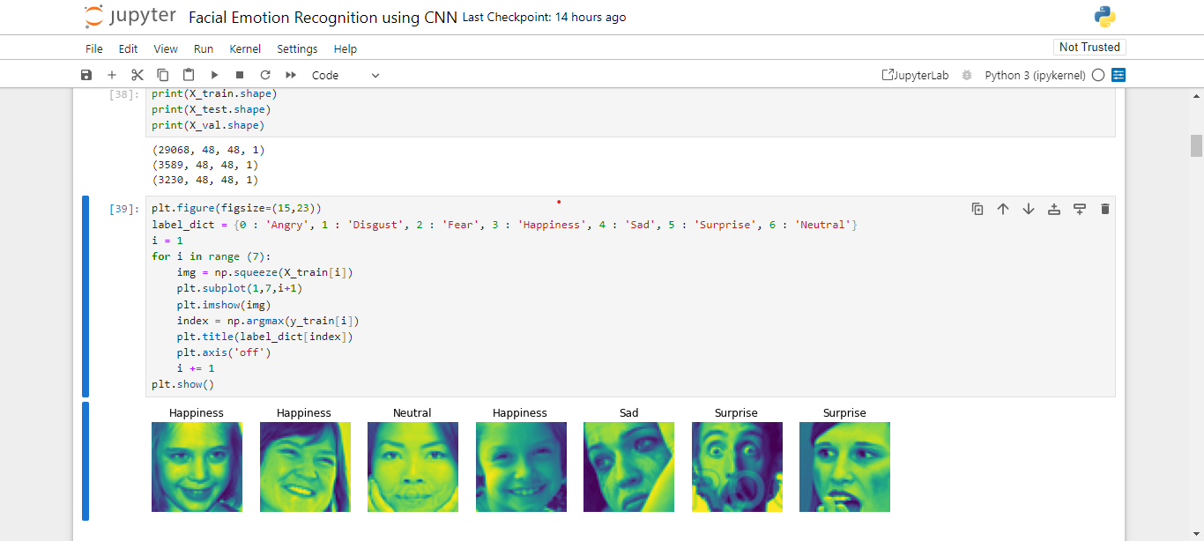
RESULTS
10

